Slide 1
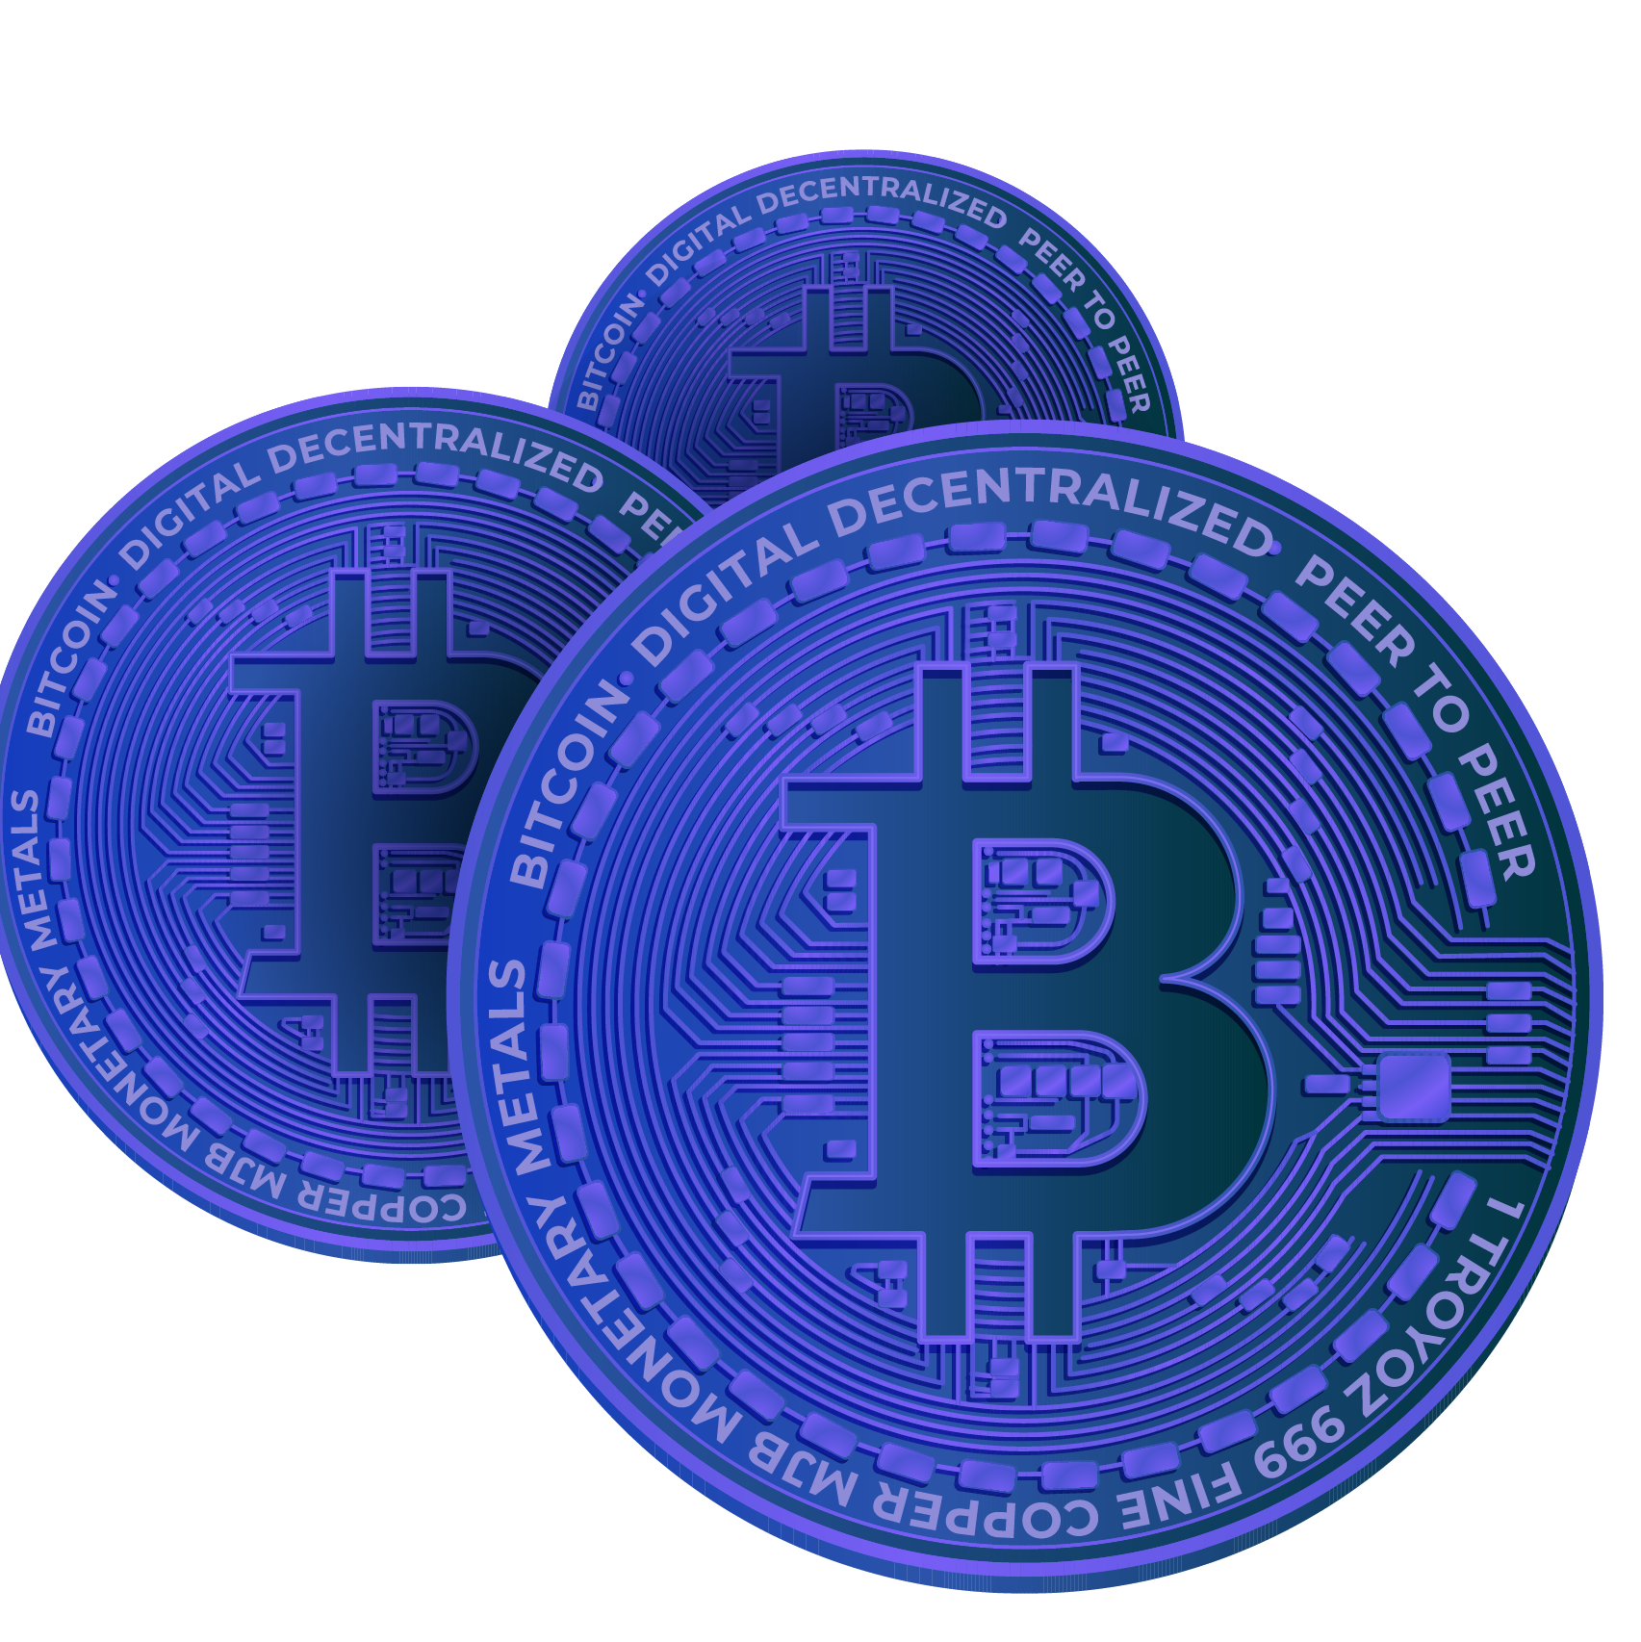
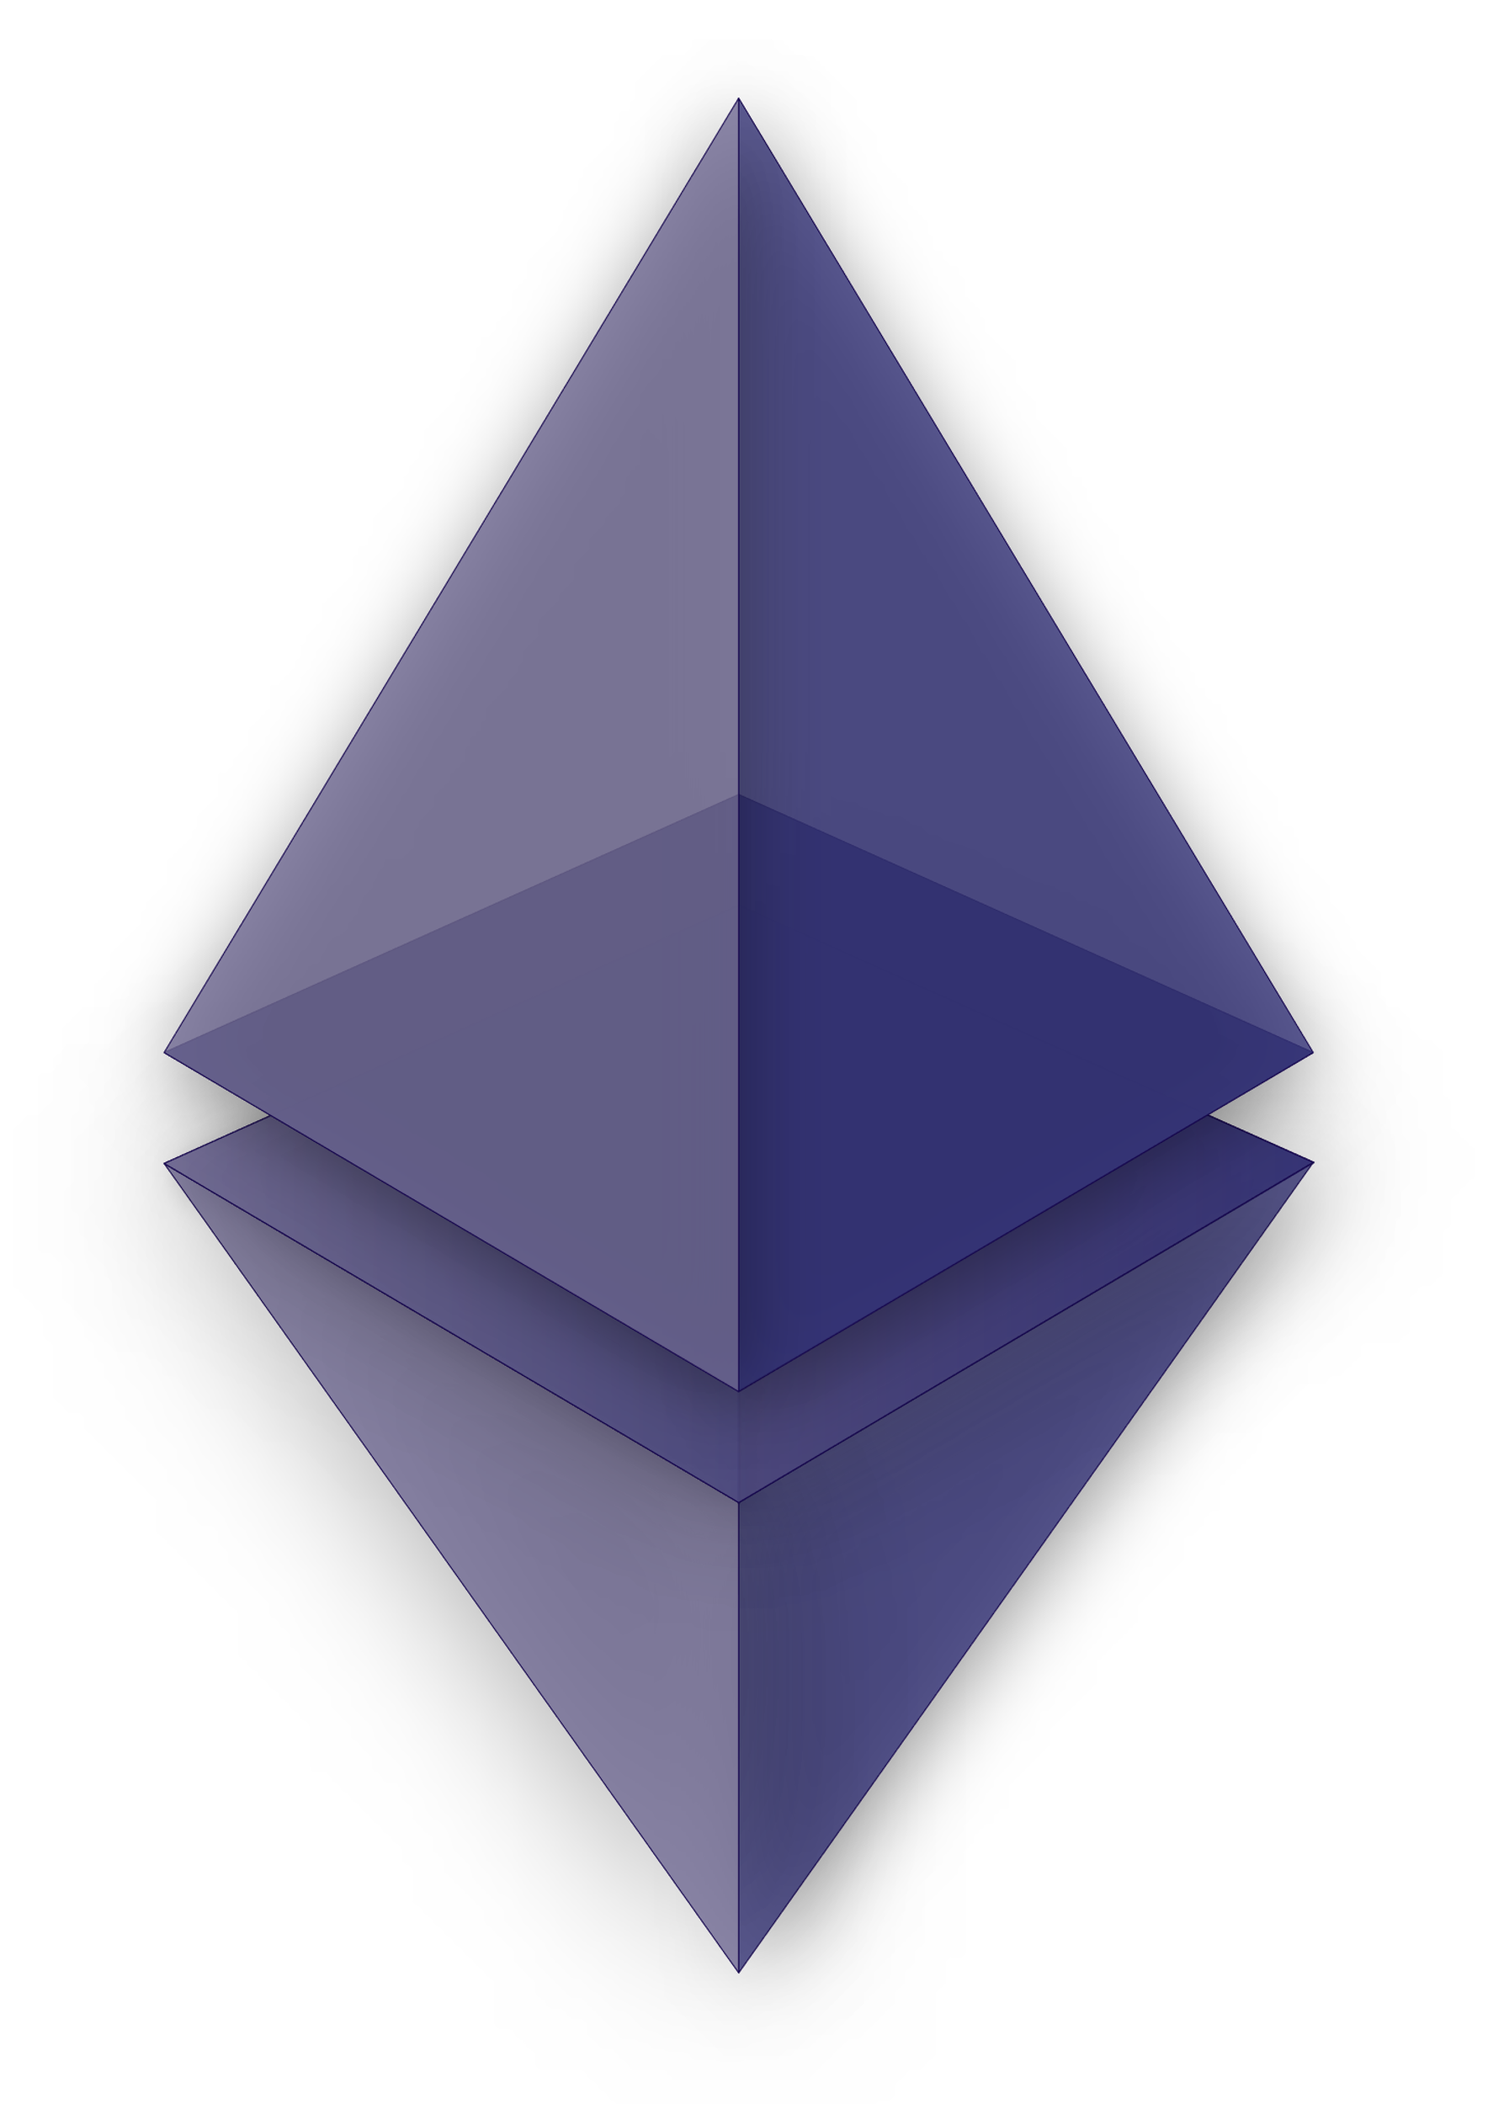
Blockchain based Crowdfunding Dapp
a web 3.0 based dapp
Notes:
1. Table of contents
2. Introduction
3. Our company
4. Our team
5. Problem
6. Them vs. us
7. Solution
8. SWOT analysis
9. Product overview
10. Our plans
11. Product demo
12. Traction
13. Case study
14. Reviews
15. Awards
16. Market size
17. Target
18. Competitors
19. Business model
20. Timing
21. Predicted growth
22. Investment

Slide 2

Team Members
Mohammad Enan Al Harun Sahan
ID: 20101095
Md. Asadujjaman Noor
ID: 20101101
Sheikh Nafez Sadnan
ID: 20101106

Slide 3
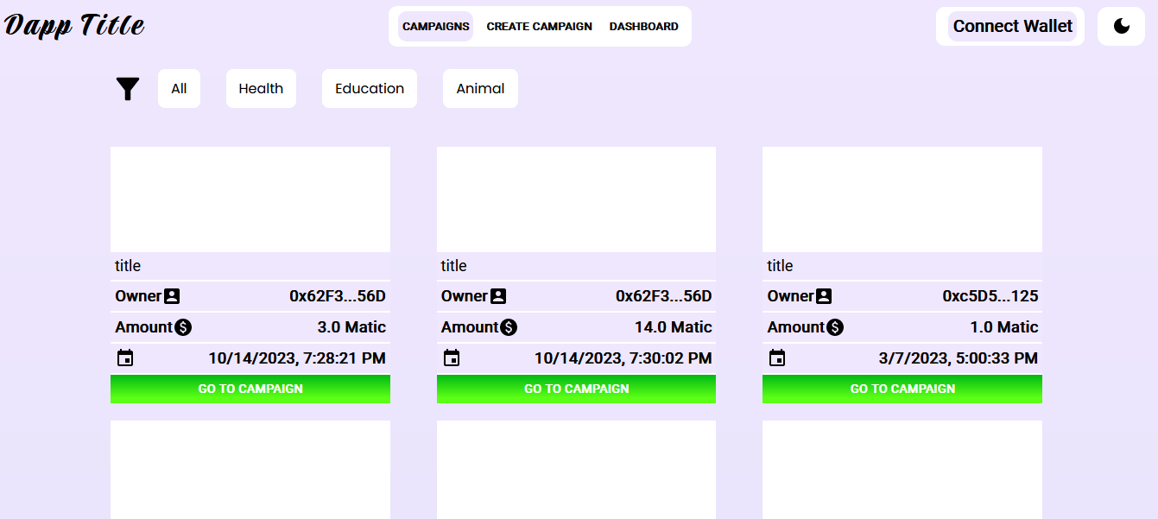
Campaigns Page

Slide 4
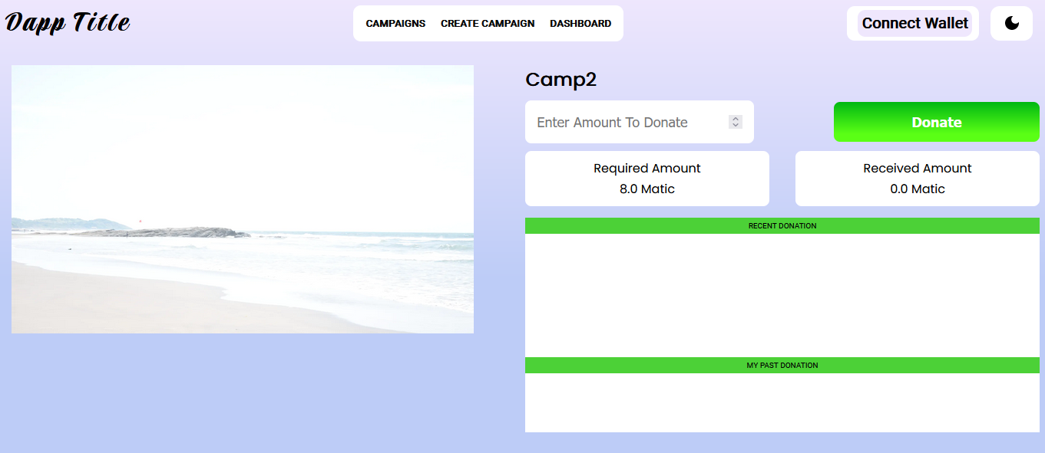
Campaign Details

Slide 5
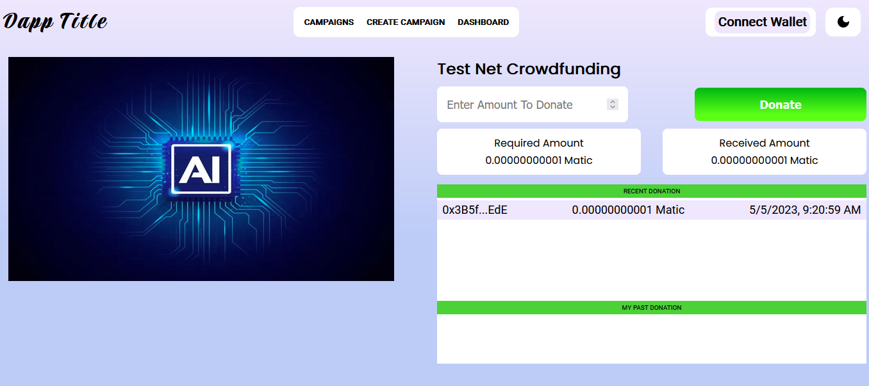
After Donation

Slide 6
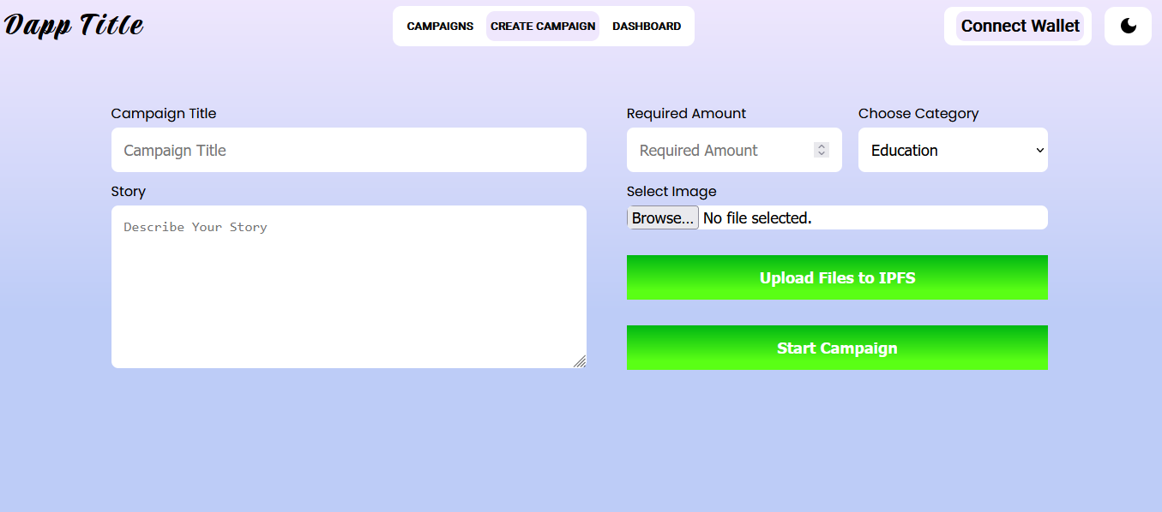
Create Campaign

Slide 7
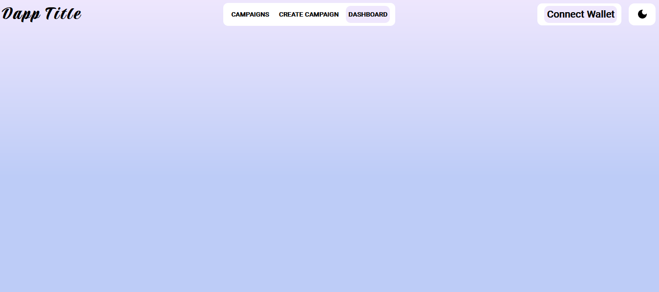
Dashboard

Slide 8

Thank you!

